Slide 1
Virtual Computer: Multi-System Apps & I/O
Kevin Boos
Rice University
Efficient Computing Group
Notes:
Today I’m going to talk about our vision for a Virtual Computer, that allows applications to run and use I/O from from multiple distributed devices.
We’re working to implement support for this at the OS level.

Slide 2
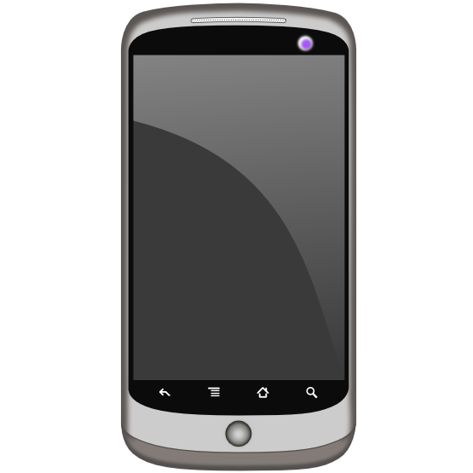
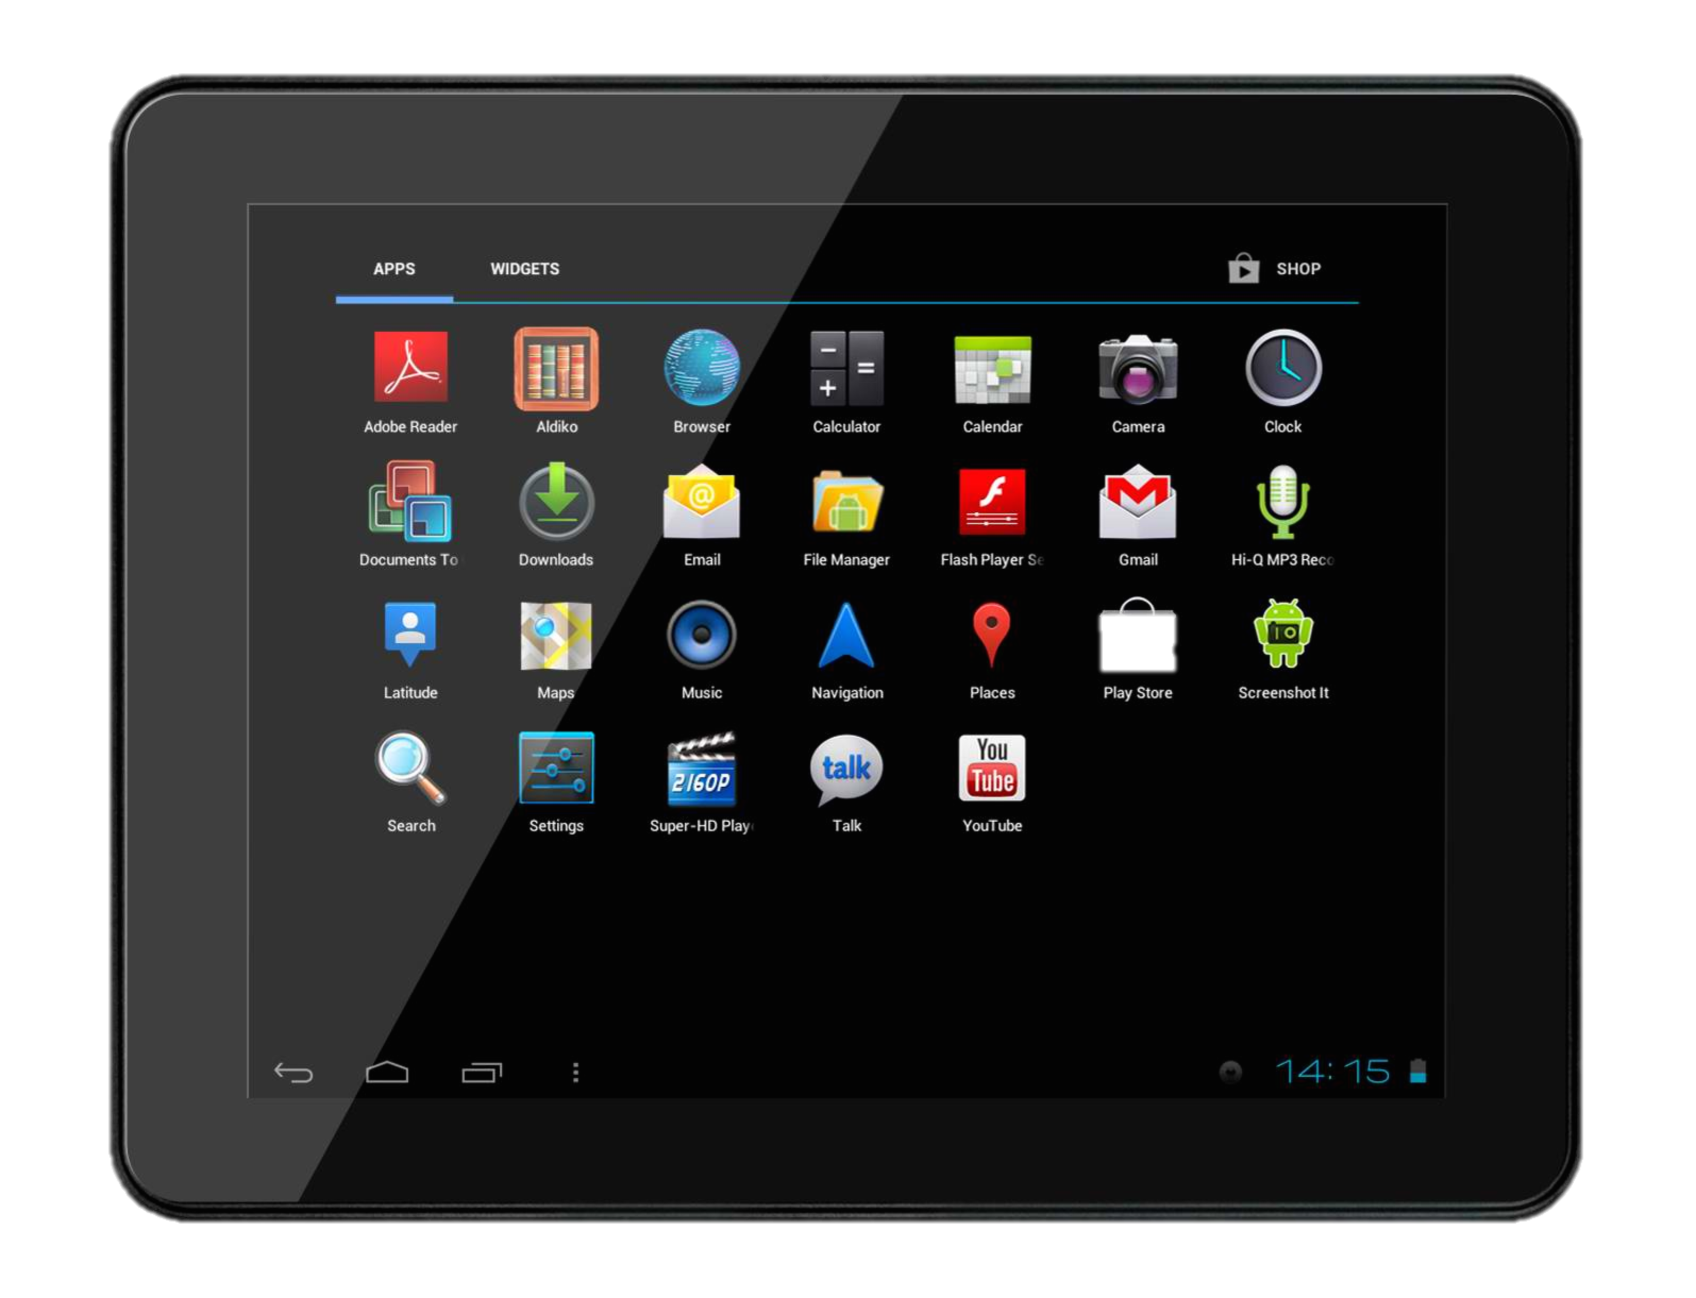
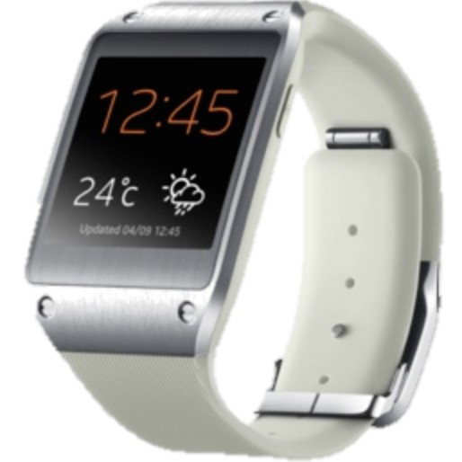


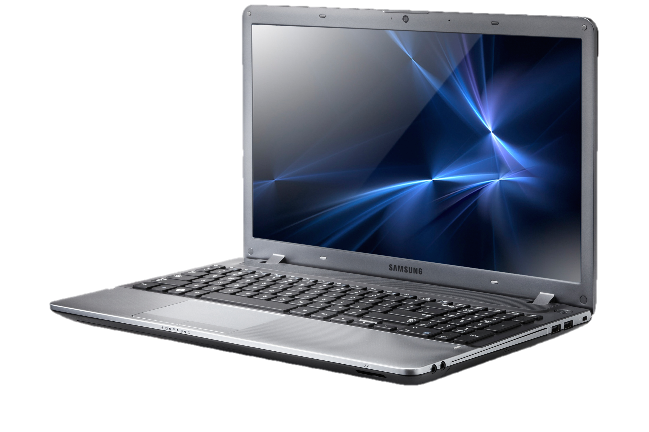


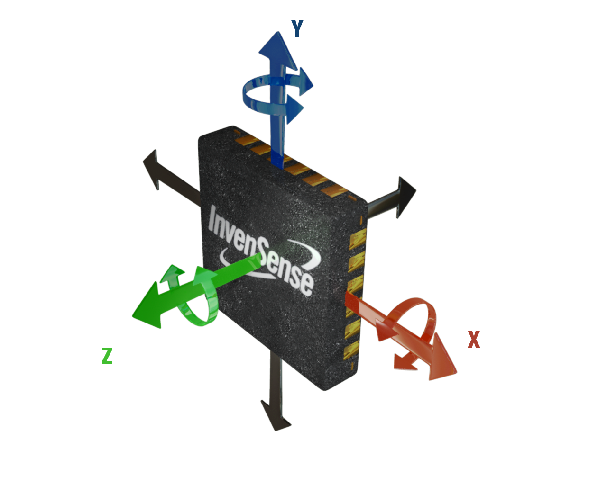
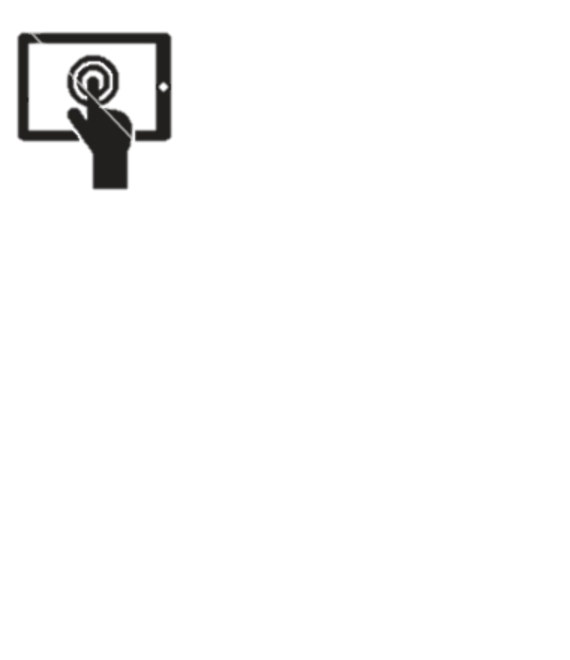


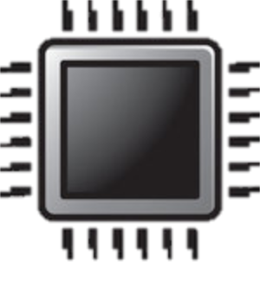

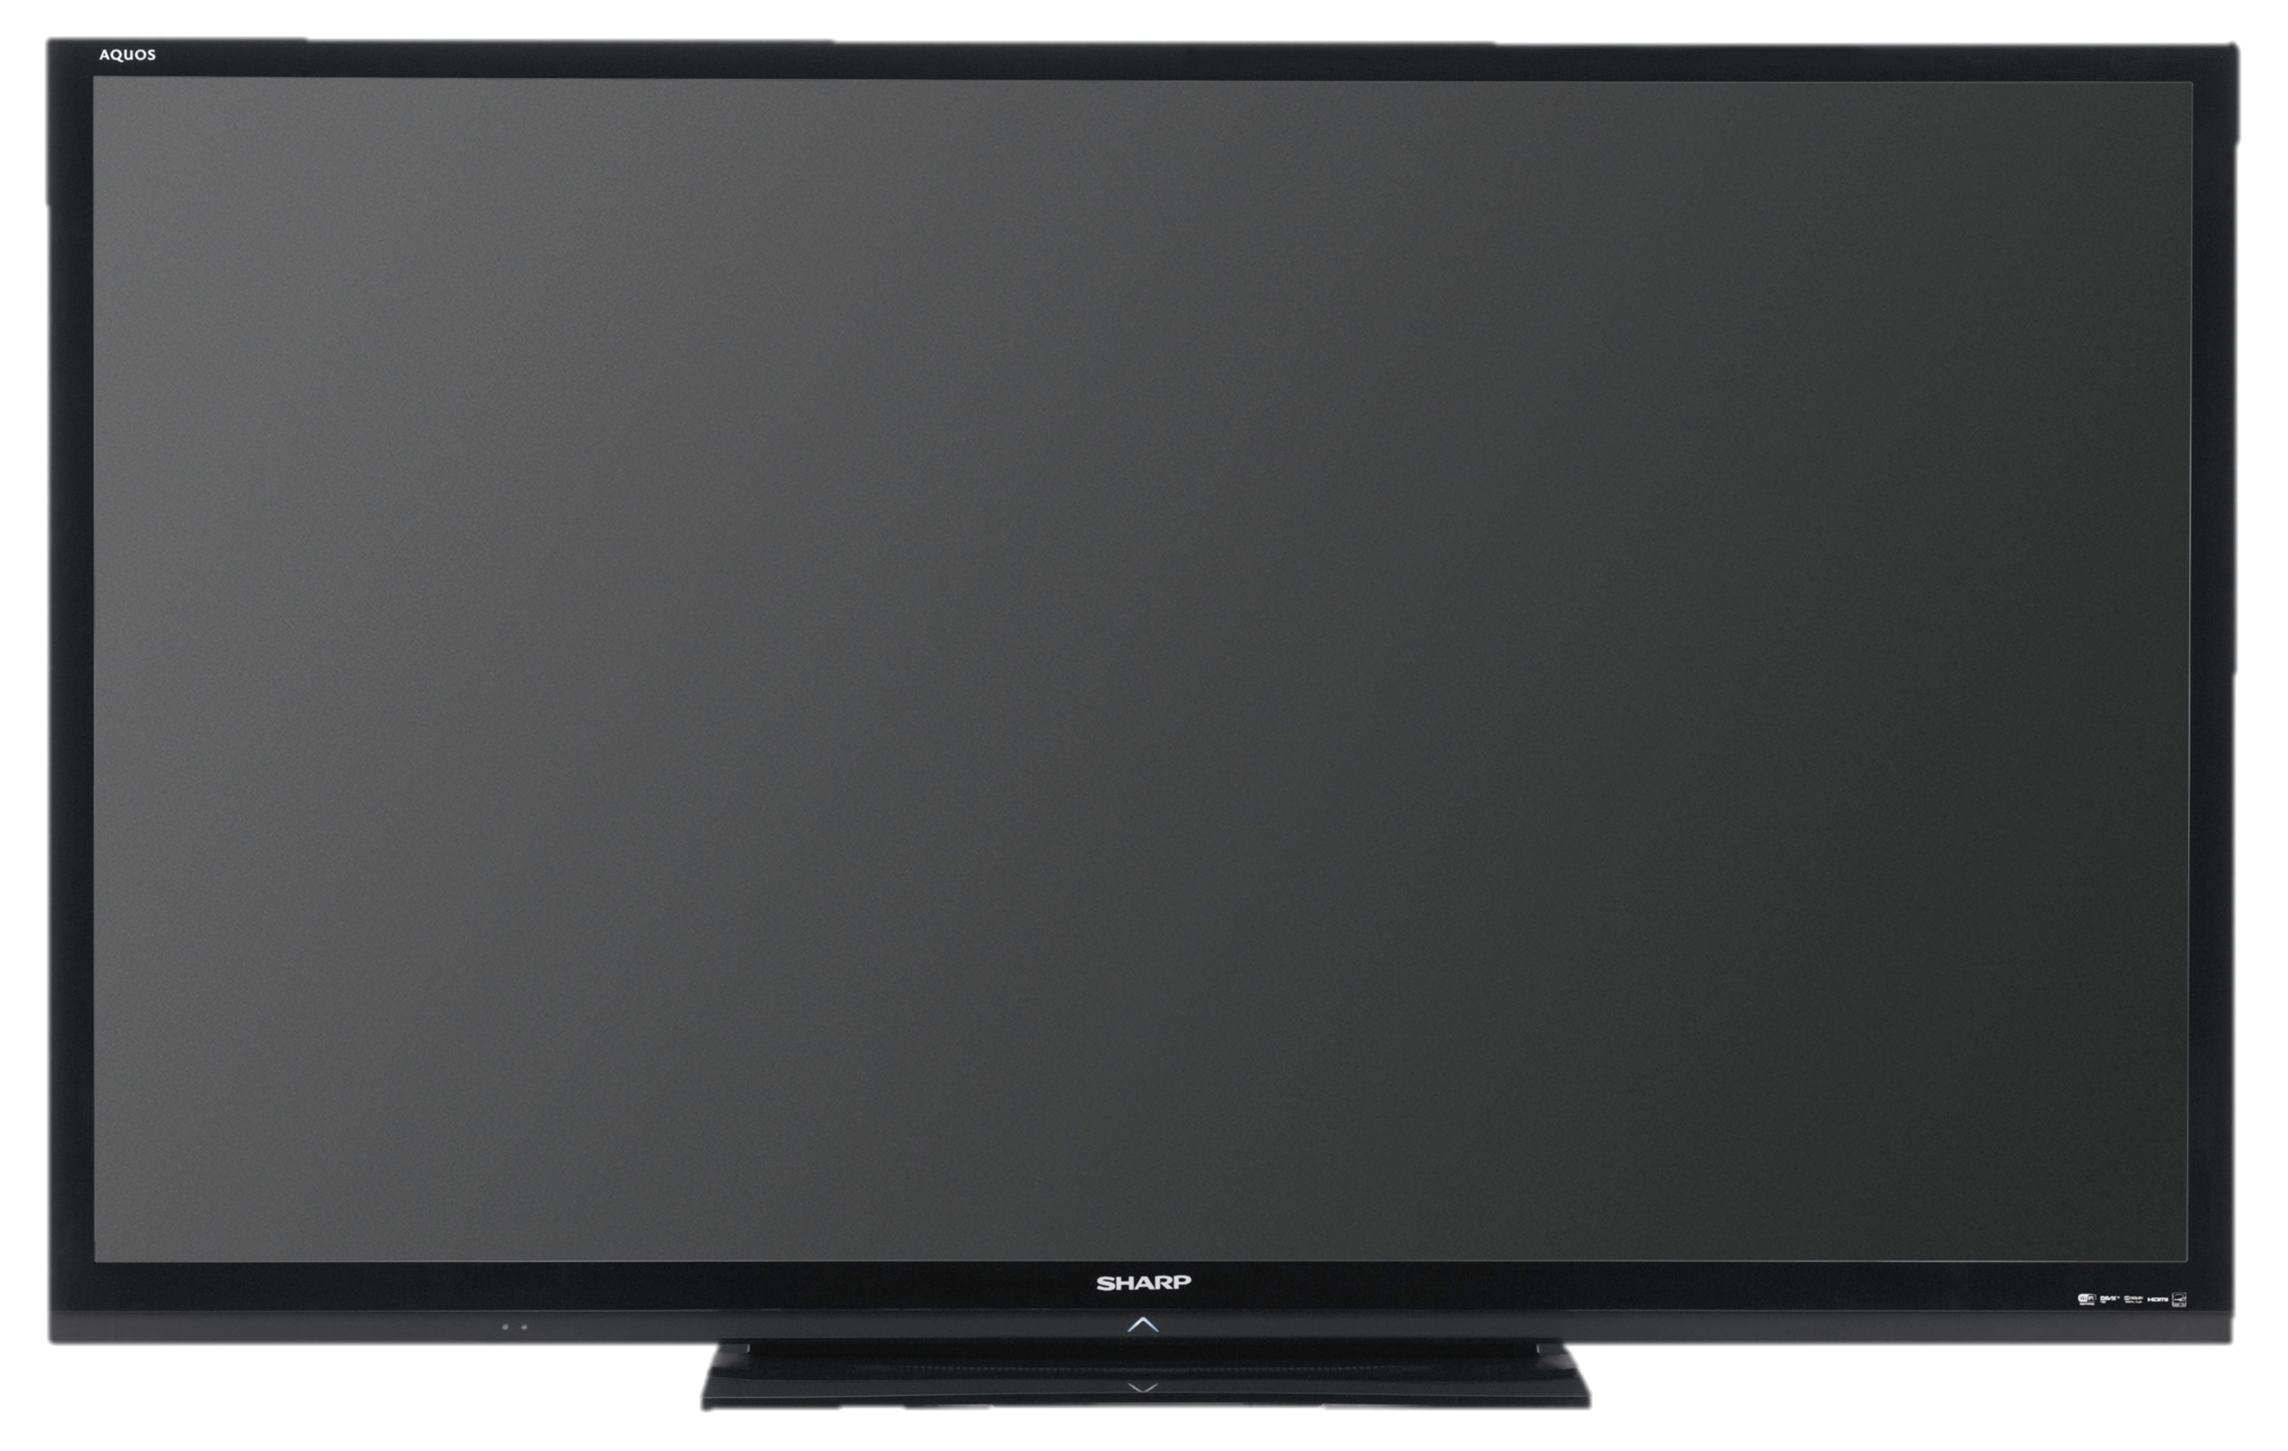
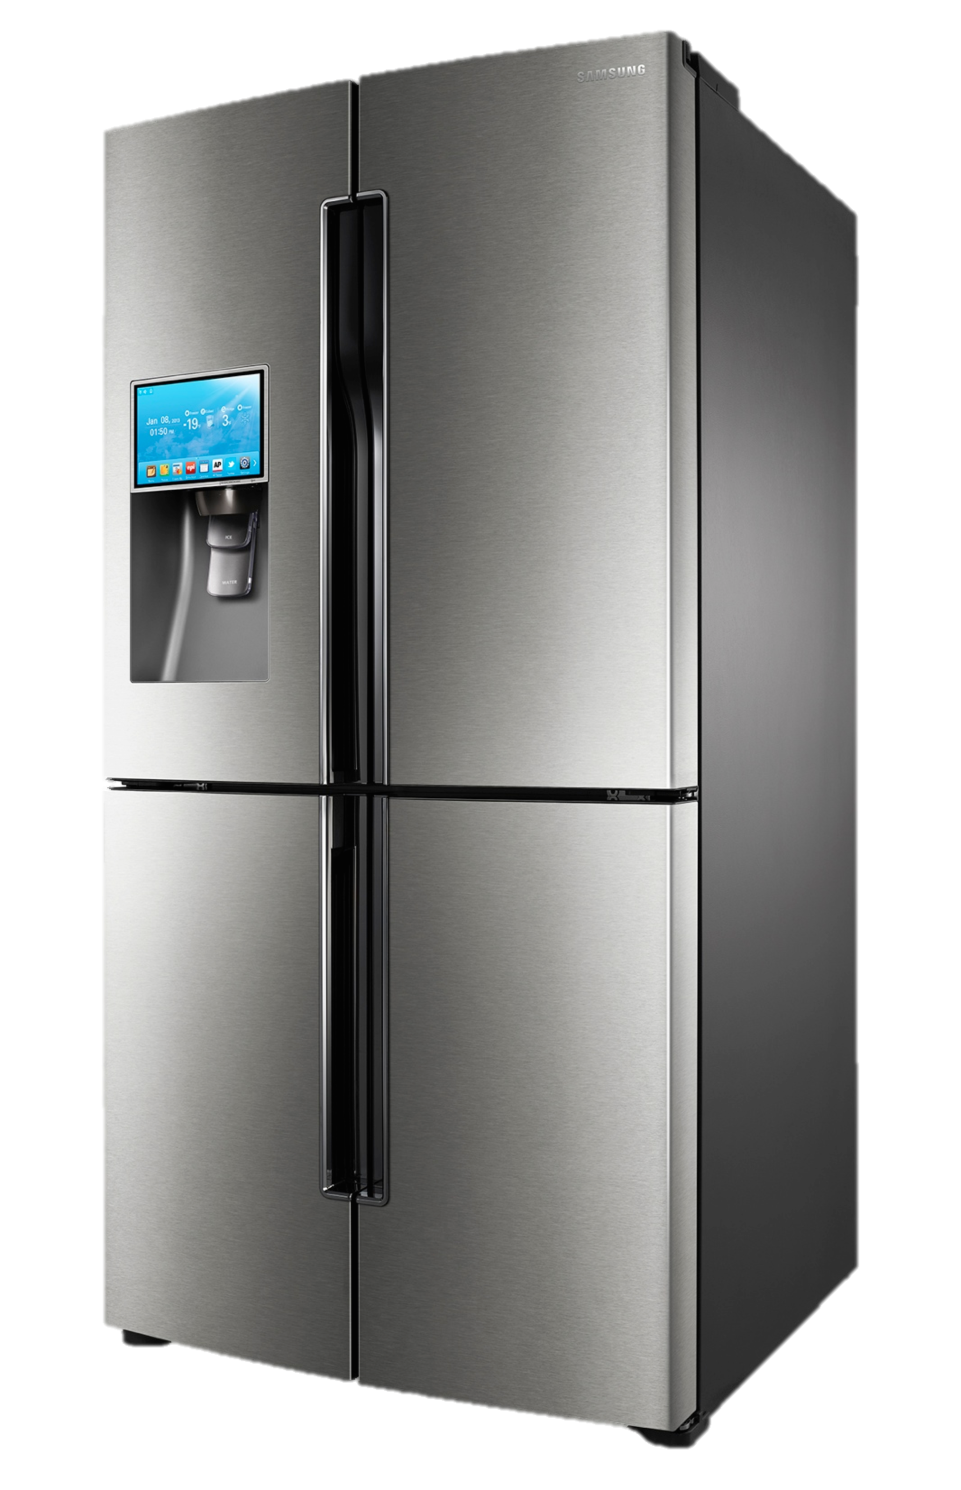



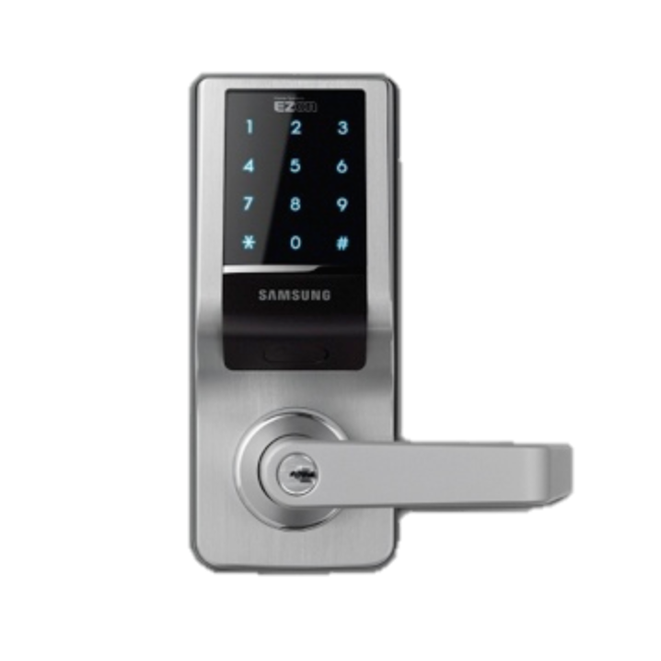
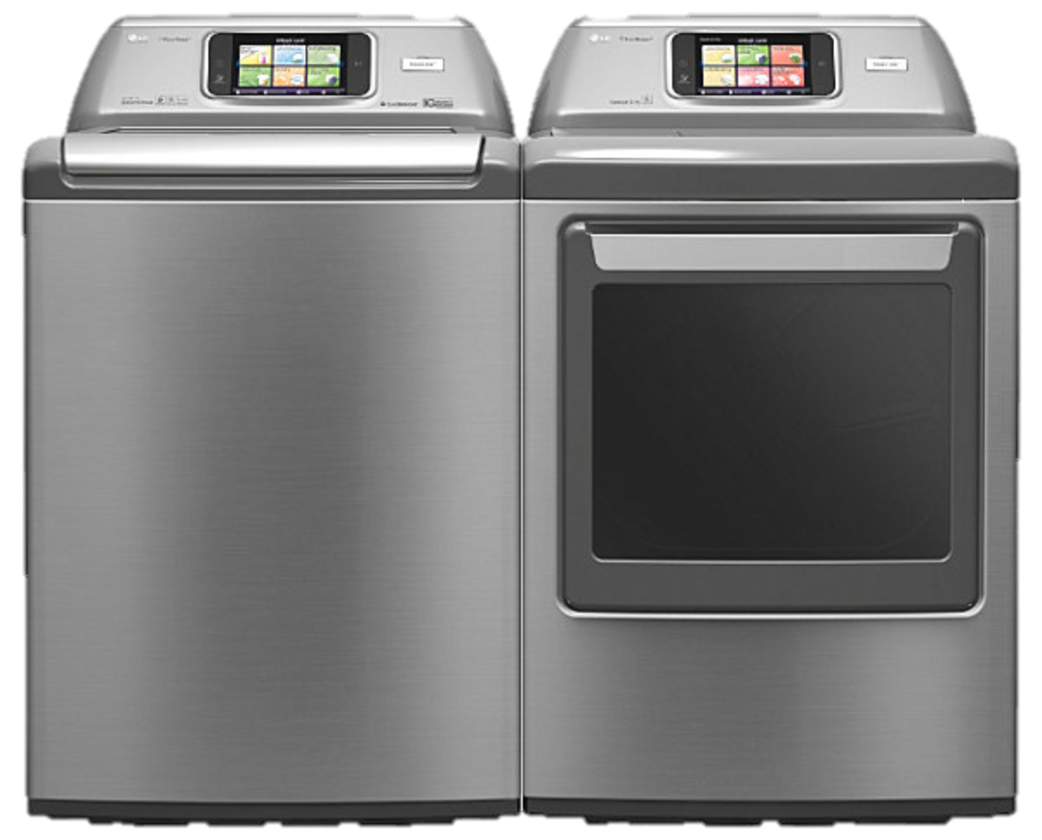
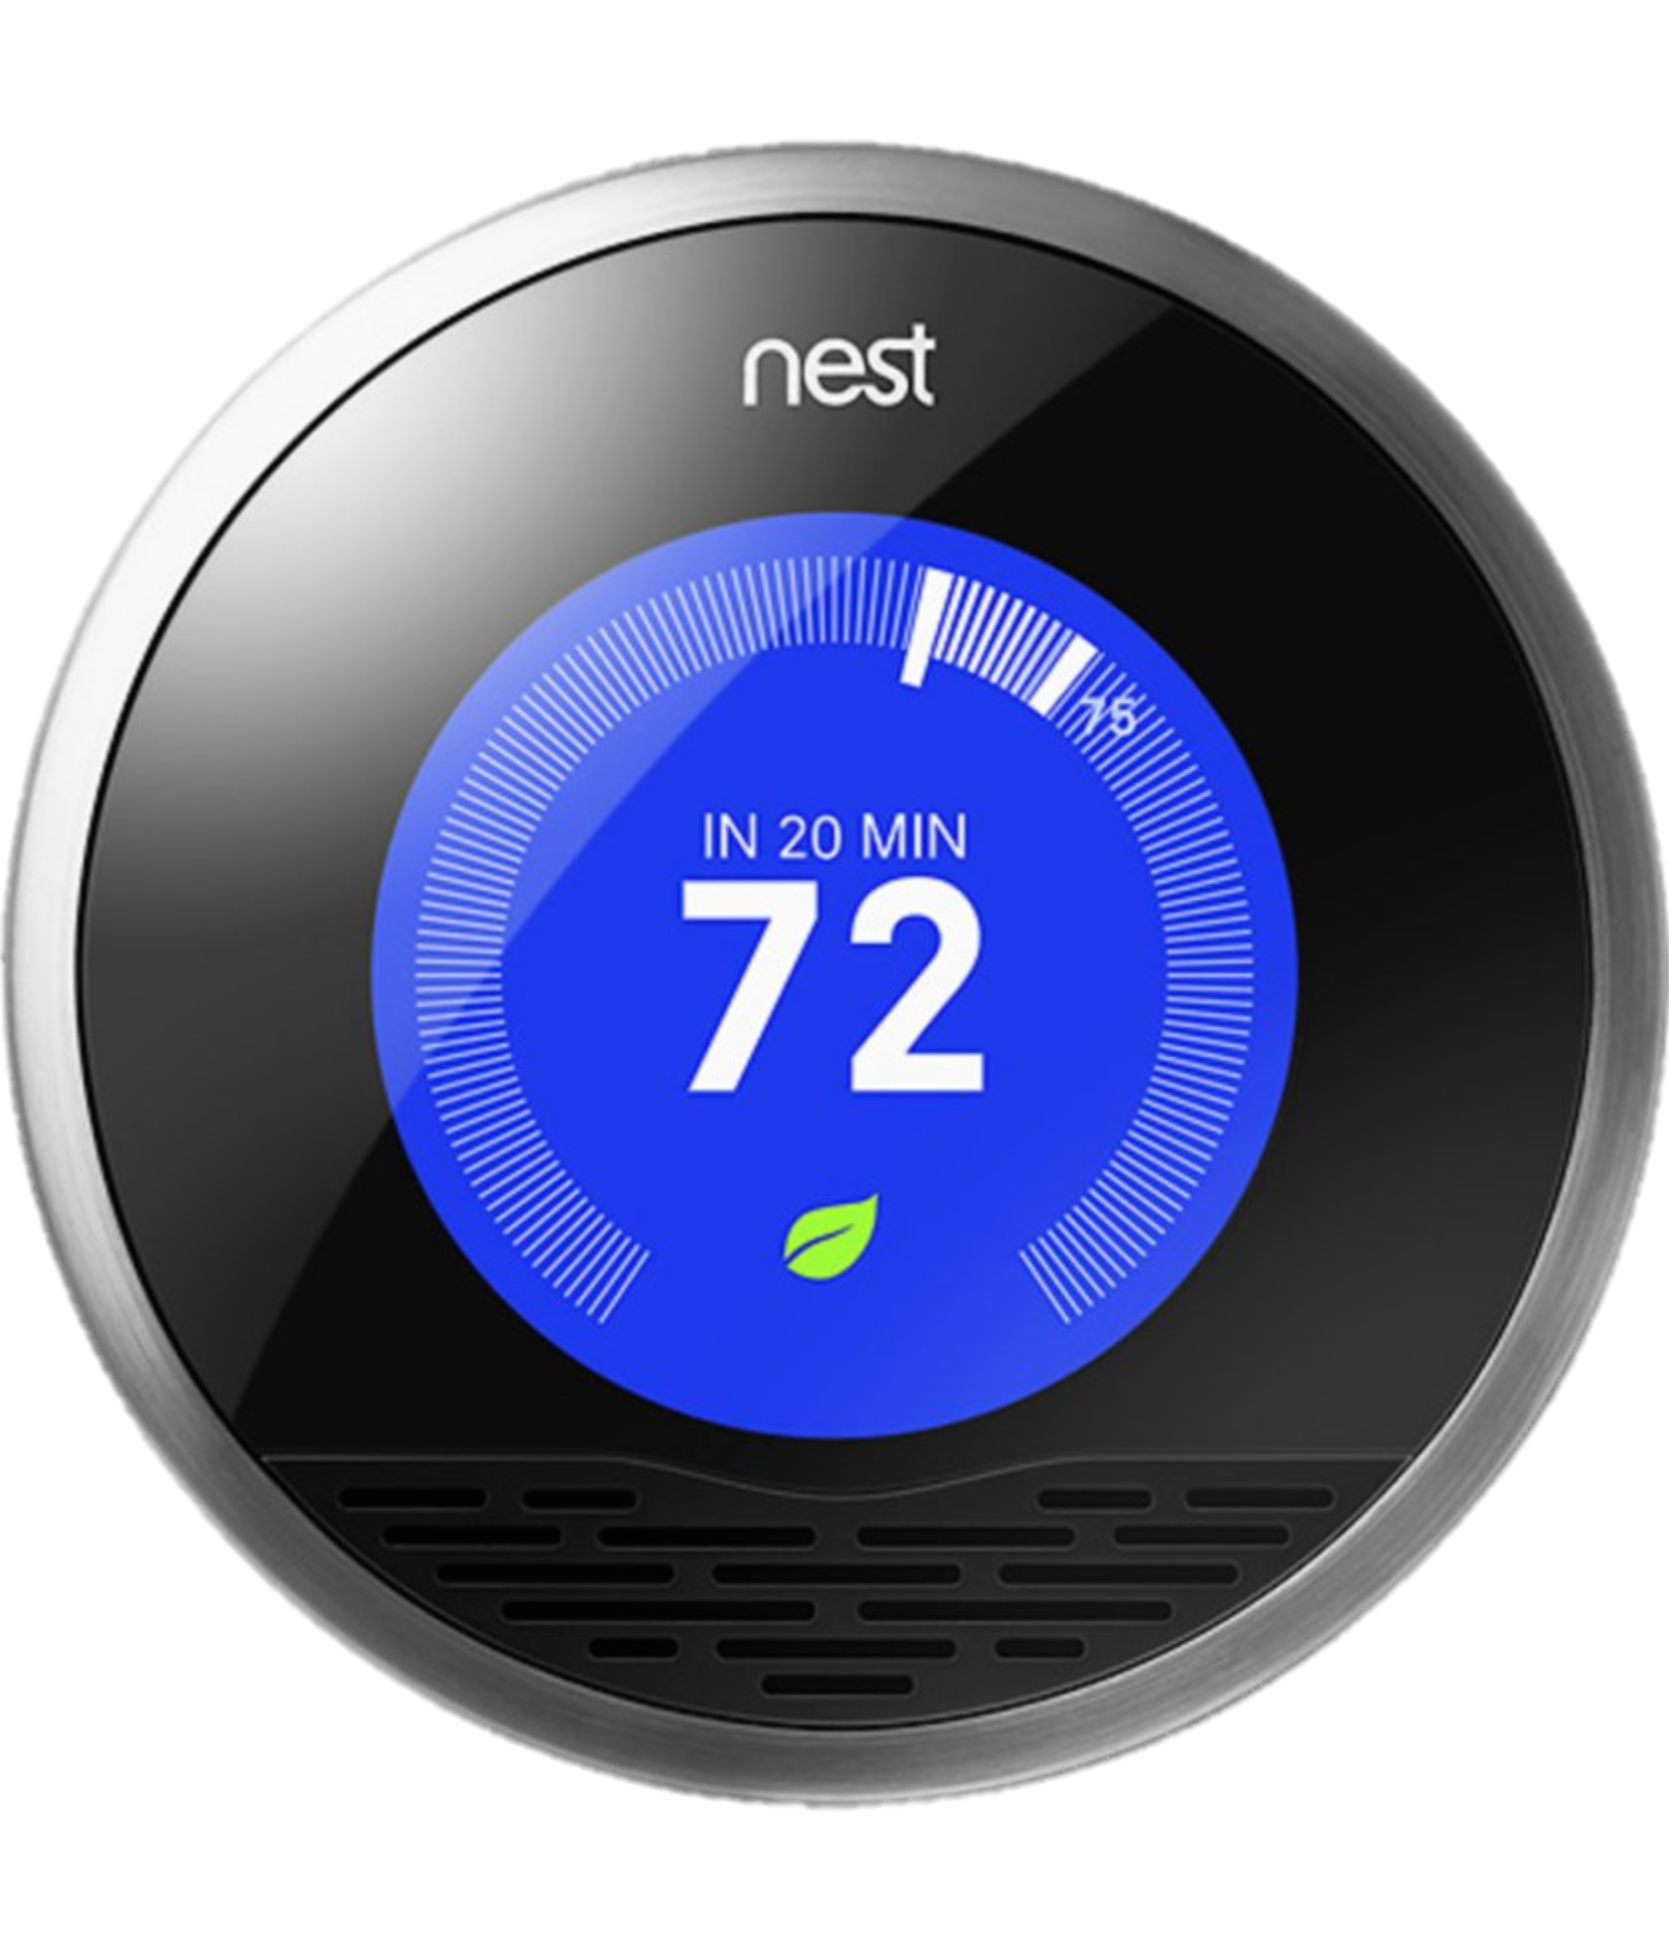
Vision: Virtual Computer
Notes:
How many devices do you have on your person?
What about in your home?
All devices are connected
They all have their own I/O devices

Slide 3

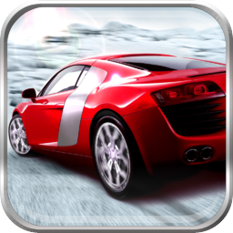
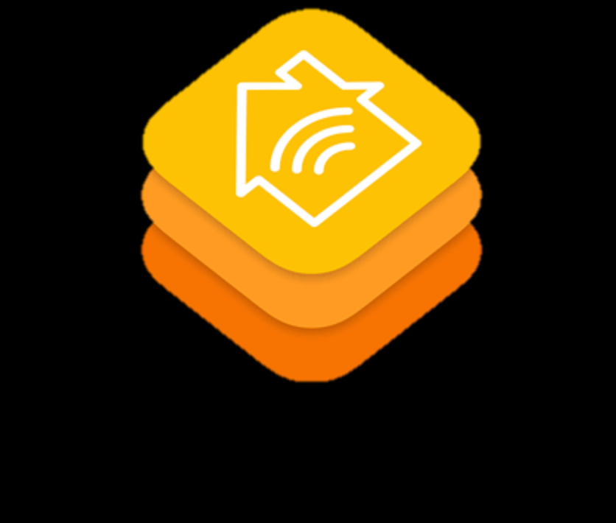

Vision: Virtual Computer
Notes:
How many devices do you have on your person?
What about in your home?
All devices are connected
They all have their own I/O devices
We want to aggregate all the I/O and other resources together
Present all resources to the application in a single instance so that each app

Slide 4
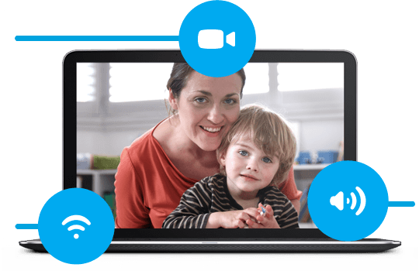
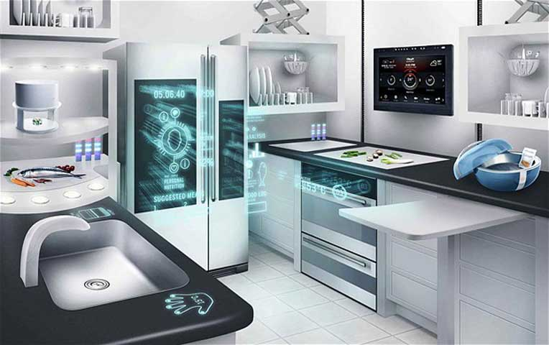
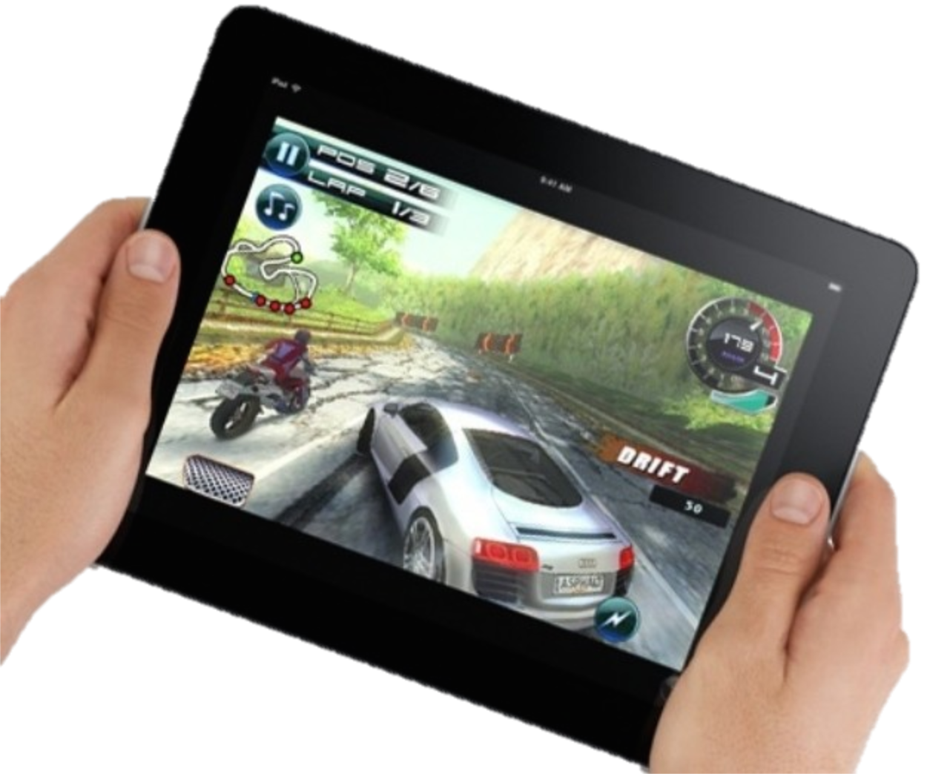
Scenarios
Video Chat
Smart home
Mobile Gaming
Notes:
Just to give you some concrete scenarios, think about a video chat application.
Skype chat
Transfer video call between devices
Utilize remote I/O
Mobile gaming
Migrate in-session game to another device
Expand across multiple devices
Multiplayer gaming
Smart home
User ID, object tracking
Energy/utility management

Slide 5
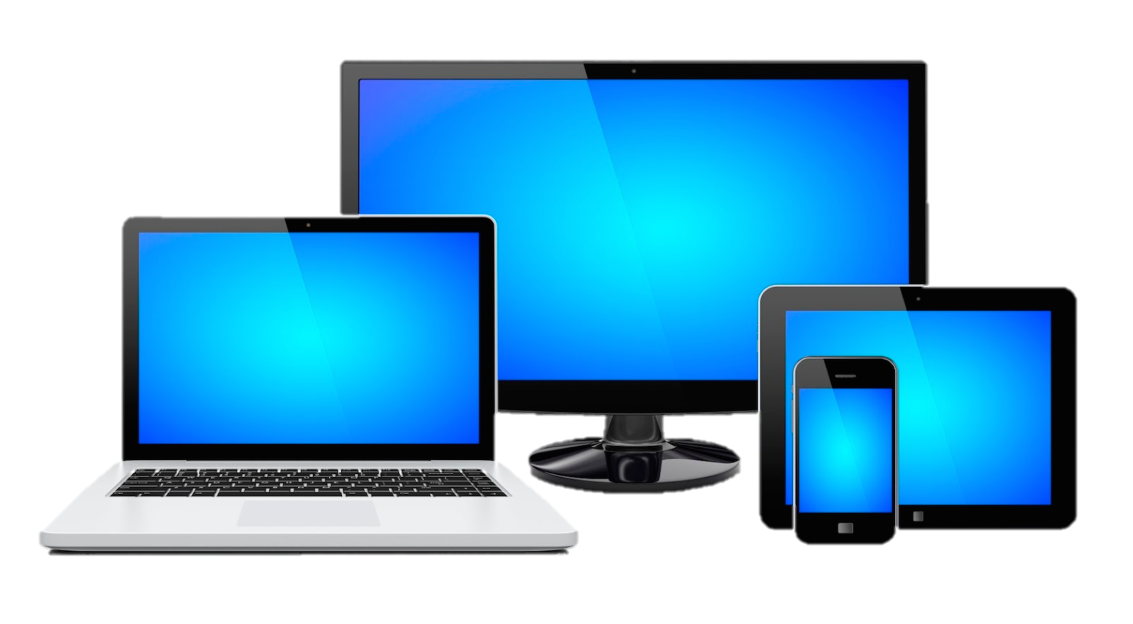
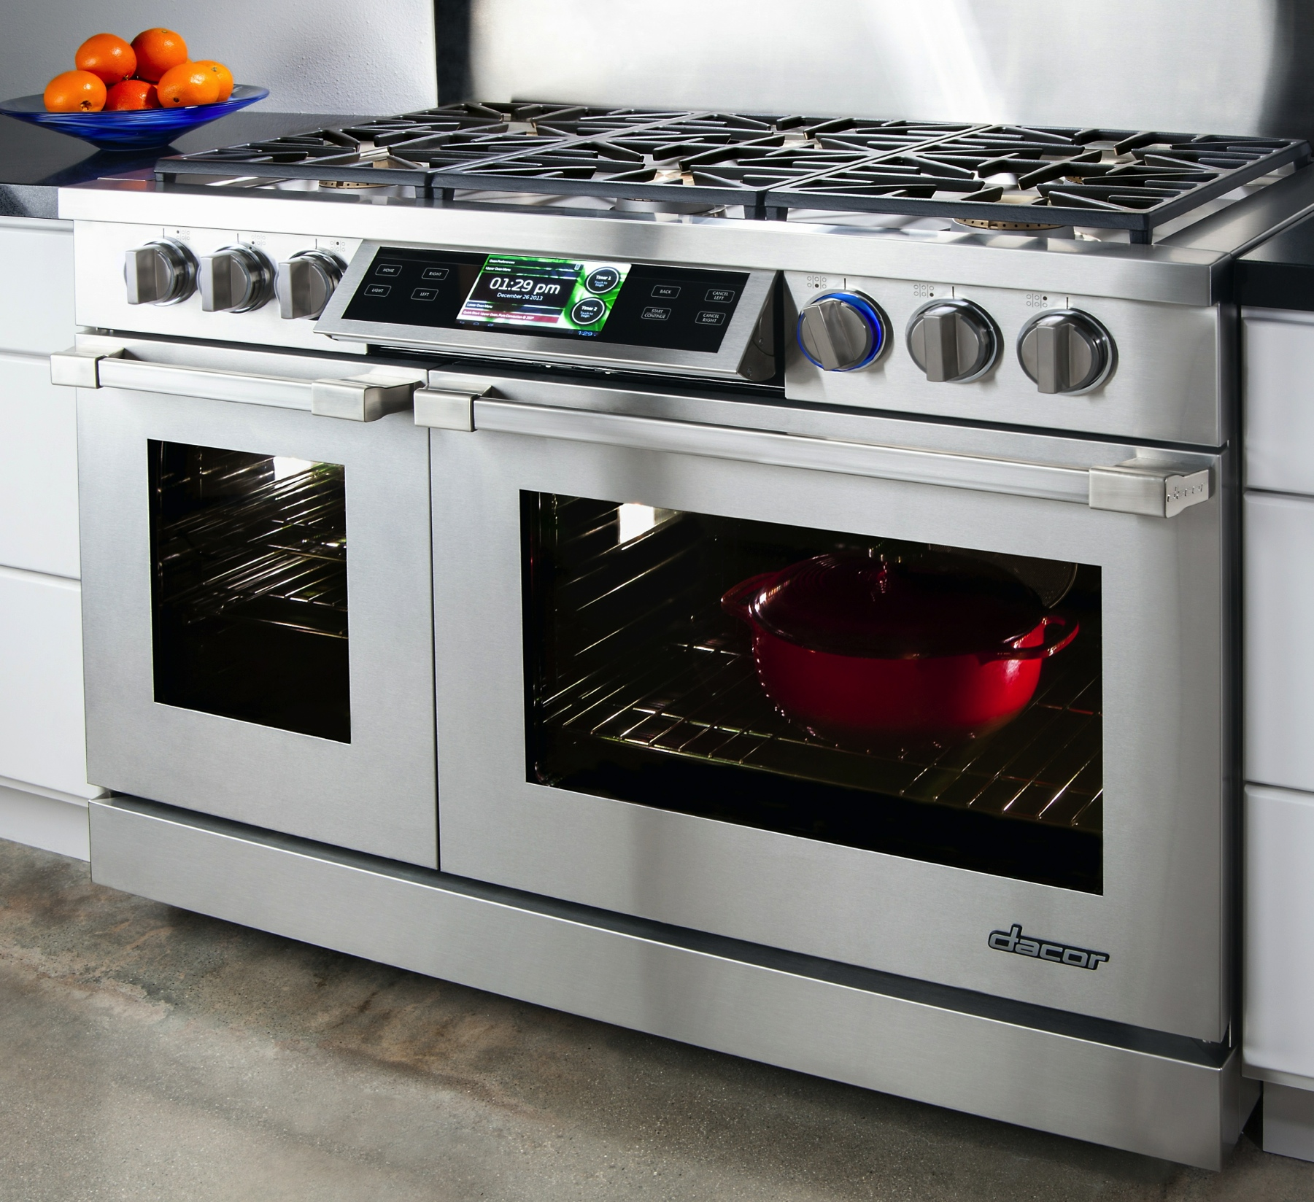
Why do we need VC?
Simultaneous/sequential use
Transition = loss of application state
How to handle multi-system states?
Systems are increasingly:
Capable — smart
Varied in form factor and I/O
Based on a Unix-like OS
Notes:
Why do we need the VC abstraction?
Well, How many devices do you have on your person? 3? 4? 5?
A single user/environment has many capable devices (mobile or fixed)
The way we interact with these mobile devices is changing as we add more and more of them to our daily repertoire.
May use multiple devices simultaneously or sequentially, switching between them occasionally
Must manually reconstruct application state on new device
Cloud-supported services offer some state synchronization in an application-specific manner
How do we as users and developers manage application states across all these devices?

Slide 6
OS-level VC Approach
Notes:
So there’s a disparity between

Slide 7
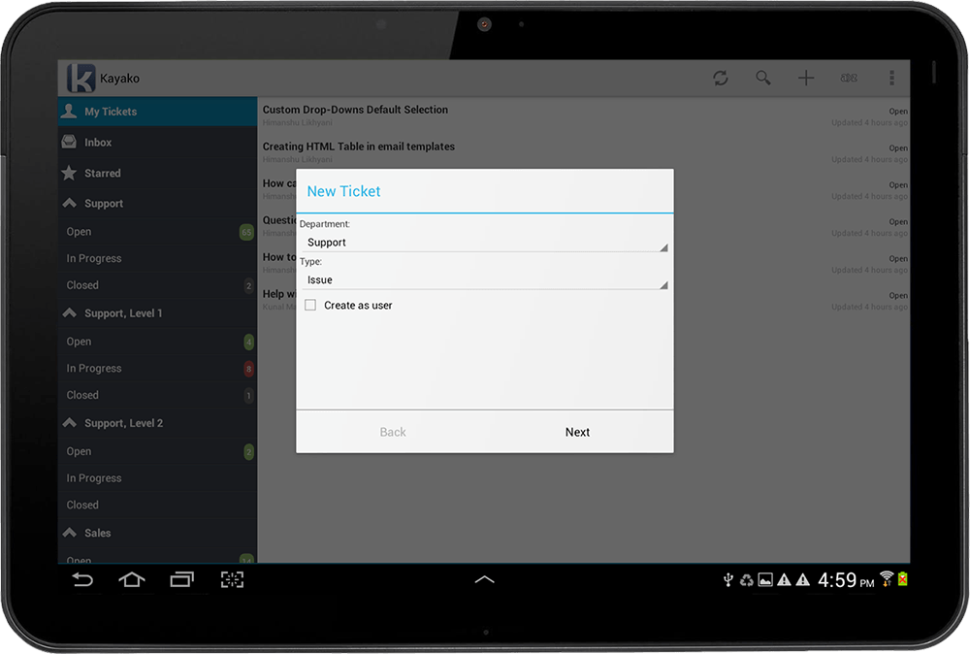

1) I/O Sharing
Rio: System Support for Remote I/O
Access I/O on remote mobile system as if it were local
Generic, widely-compatible interface: device file
Learn more at Ardalan’s talk
Thursday morning bright & early! Session 7, 9:00am
Notes:
Rio targets I/O devices found on mobile systems, like cameras, modems, speakers, microphones,
Because good solutions already exist for sharing of traditional computing resources like processors and storage.

Slide 8
2) Application Mobility
Migrate /spread application components across systems
Significant systems challenges
Synchronization of underlying memory (DSM)
Capture & representation of I/O states
Application
Operating System
Kernel
Kernel
Kernel
Hardware

Slide 9
Prior Work
Sharing of traditional computing resources – solved
Processing, storage, network, etc.
Middleware – requires complex, per-system effort
Poor feature support, never widely adopted
VM Migration – too heavyweight
Checkpoint/restore concepts are useful
Single system image – lacks generic I/O support
vNUMA, OpenSSI

Slide 10
VC Summary
Aggregates resources (I/O) into a single abstraction
Applications see individual, tailored VC instance
Not a virtual machine, not middleware
Makes programming easy
Distributed nature is transparent
Supports legacy and new apps
Notes:
And the VC instances are isolated just like virtual machines.
Code portability
Interactive performance
Adjustable latency
Easy system management for end users

Slide 11
Notes (ignore this slide)
Many mobile devices = distributed system
Concepts from the ‘80s & ’90s are returning
Access resources from anywhere
Computation, storage are solved
What about I/O?
Current/previous work: access I/O remotely
I/O data/state is brought to the application
Why not bring the application to the I/O device?
I/O and application instance must be colocated
Application state must be migrated to reside on same device as I/O

Slide 12
What do we have?
Application instances are married to hardware
Synchronization, if any, is ad-hoc
No system support
Arduous developer effort per app
Notes:
Are mobile apps as mobile as the devices they run on? No. They’re inflexible! They expect a stable view of local resources

Slide 13
The time is now!
Systems are increasingly:
Capable, always connected — smart
Varied in form factor and I/O devices
Based on a Unix-like OS
Sharing of traditional computing resources – solved
Processing, storage, network, etc.
Notes:
Here are some of our observations that show now is the right time to tackle this problem.
The time is now to realize this vision, but what do we have now that earlier attempts didn’t?
Apples WWDC – homekit
Google I/O expected to focus on wearables

Slide 14
Two-step approach
I/O Sharing
Bring I/O to the application
Application Mobility
Bring application to the I/O
Execution follows the user
Notes:
The first step is I/O Sharing, where we bring I/O to the application.

Slide 15
Benefits of VC
Distributed nature is transparent
Supports both legacy & new apps
Secure isolation of VC instances
Code portability
Interactive performance
Adjustable latency
Easy system management for end users
Notes:
Application developers are not aware of the distributed nature of various resources, such as on what physical machine each I/O device exists.
Adjustable latency: for short-running operations that access a remote I/O device just once briefly, the initial delay of migrating an application to be colocated with the I/O will most likely outweigh the benefits. But for longer-running operations that are interactive or require continually low latency (streaming data), the initial delay might be worth the sacrifice.
Easy device management: user only needs to manage a single set of states, a virtual computer; instead of multiple rather isolated sets

